Slide 1
Generation of Melody With Generative Adversarial Network
Class project for CSE 5523
Autumn ‘18
Soham Mukherjee
Pavani Komati
Rupen Mitra

Slide 2
AGENDA
The Project
Data in Use
Proposed Model
Result
Evaluation
Conclusion

Slide 3
THE PROJECT
Generation of piano melody using GANs
Providing raw piano melodies to the GAN
Expect synthetic piano melody composed by AI

Slide 4
Data in Use
Midi files of Piano Melody
The training data consists of 10 different melodies taken from different Beatles songs
Source:
https://github.com/konstilackner/LSTM-RNN-Melody-Composer/tree/master/trainData/melody

Slide 5
Raw MIDI Data
<meta message track_name name='001\x00' time=0>
<meta message time_signature numerator=4 denominator=4 clocks_per_click=36 notated_32nd_note
s_per_beat=8 time=0>
<meta message time_signature numerator=4 denominator=4 clocks_per_click=36 notated_32nd_note
s_per_beat=8 time=0>
note_on channel=0 note=77 velocity=102 time=0
note_off channel=0 note=76 velocity=127 time=0
note_on channel=0 note=67 velocity=81 time=48
note_off channel=0 note=74 velocity=127 time=0
note_off channel=0 note=67 velocity=127 time=48
note_on channel=0 note=67 velocity=104 time=48
note_off channel=0 note=67 velocity=127 time=48
note_on channel=0 note=67 velocity=103 time=72
note_off channel=0 note=67 velocity=127 time=24
note_on channel=0 note=67 velocity=100 time=0
note_off channel=0 note=67 velocity=64 time=72
note_on channel=0 note=67 velocity=108 time=0
note_off channel=0 note=67 velocity=127 time=24
note_on channel=0 note=77 velocity=103 time=0
…
<meta message end_of_track time=0>

Slide 6
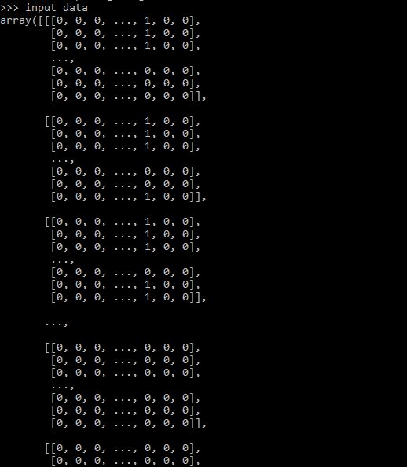
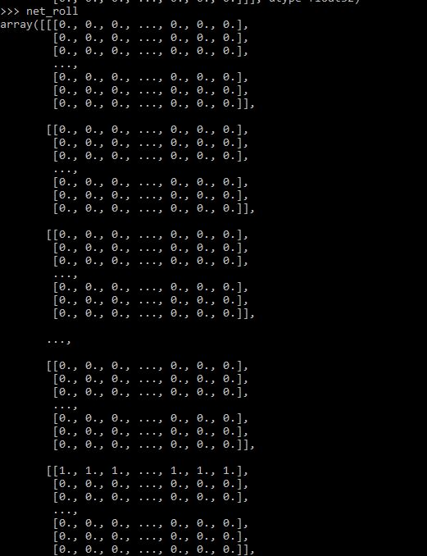
I/O Data Format
Input Piano Roll
Output Piano Roll

Slide 7
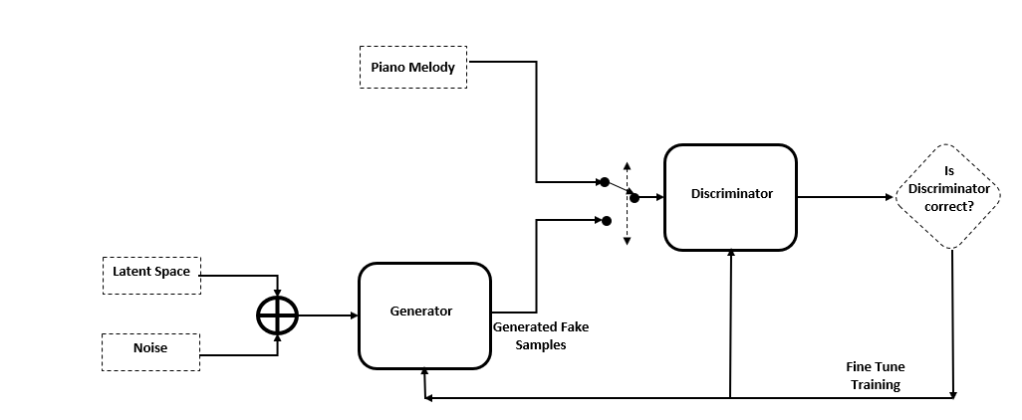
GAN Model Overview

Slide 8
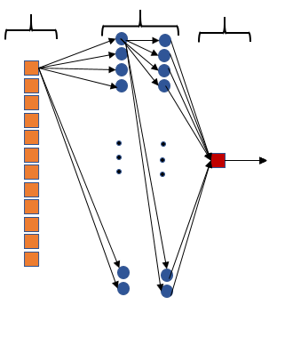
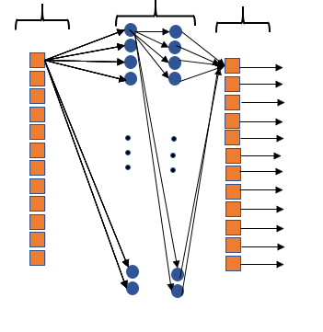
Our Model
input layer
Hidden layer
50 X 50
Output layer
input layer
Hidden layer
50 X 50
Output layer
Discriminator Network
Generator Network

Slide 9
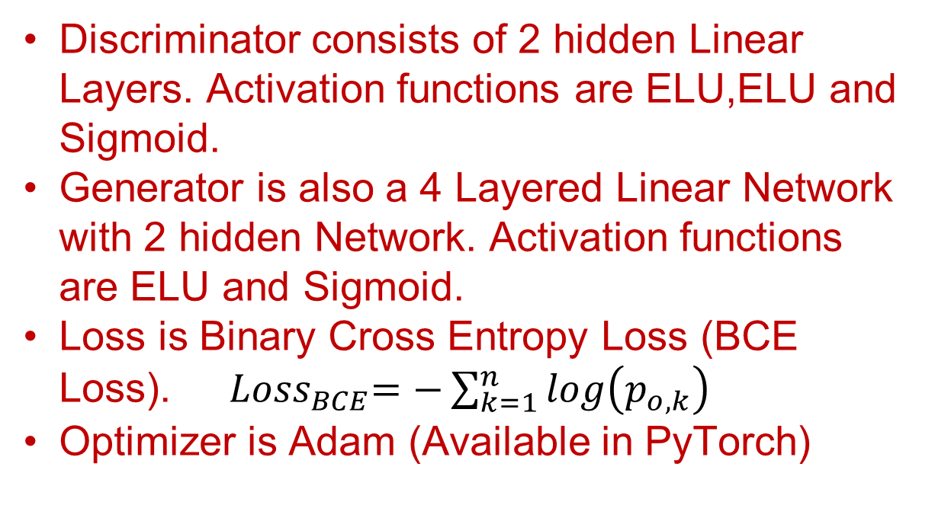
CSE 5523: Project
Our Model (Contd …)
Discriminator consists of 2 hidden Linear Layers. Activation functions are ELU,ELU and Sigmoid.
Generator is also a 4 Layered Linear Network with 2 hidden Network. Activation functions are ELU and Sigmoid.
Loss is Binary Cross Entropy Loss (BCE Loss). ${ Loss}_{BCE}=−\sum_{k=1}^{n}{log\left(p_{o,k}\right)}$
Optimizer is Adam (Available in PyTorch)

Slide 10

RESULTS
Sample INPUT
Sample OUTPUT

Slide 11
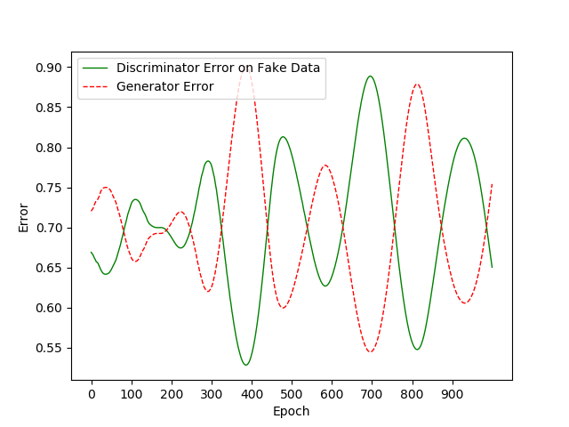
CSE 5523: Project
RESULTS cont.
Fig: Discriminator and Generator Error

Slide 12
CHALLENGES
Defining better optimization function for the GAN
GAN is sensitive to the hyper-parameter
Obtaining a pleasant melody from GAN seems challenging.

Slide 13
CONCLUSION
An exciting project to start working on!
Sophisticated GAN models such as DCGAN, MuseGANs could be used for better performance
Training and tuning the GANs are rigorous and resource consuming

Slide 14
CSE 5523: Final Project
Bibliography
[1] Generative adversarial nets I Goodfellow et al. - Advances in neural information processing systems, 2014
[2] DevNag’s Blog Post on GAN - https://medium.com/@devnag/generative-adversarial-networks-gans-in-50-lines-of-code-pytorch-e81b79659e3f
[3] https://github.com/devnag/pytorch-generative-adversarial-networks (DevNag’s code)
[4] LSTM RNN Music Composition, Konstantin Lackner, https://konstilackner.github.io/LSTM-RNN-Melody-Composer-Website/Thesis_final01.pdf
[5] https://github.com/konstilackner/LSTM-RNN-Melody-Composer

Slide 15
Thank you!

